Slide 1

A non-contact based system to measure Spo2 and systolic/diastolic BP using RGB-NIR camera
Divya Saxena
Supervised by: Dr. Manfred Huber
Committee Members: Dr. David Levine, Dr. Dajiang Zhu

Slide 2
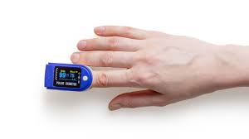
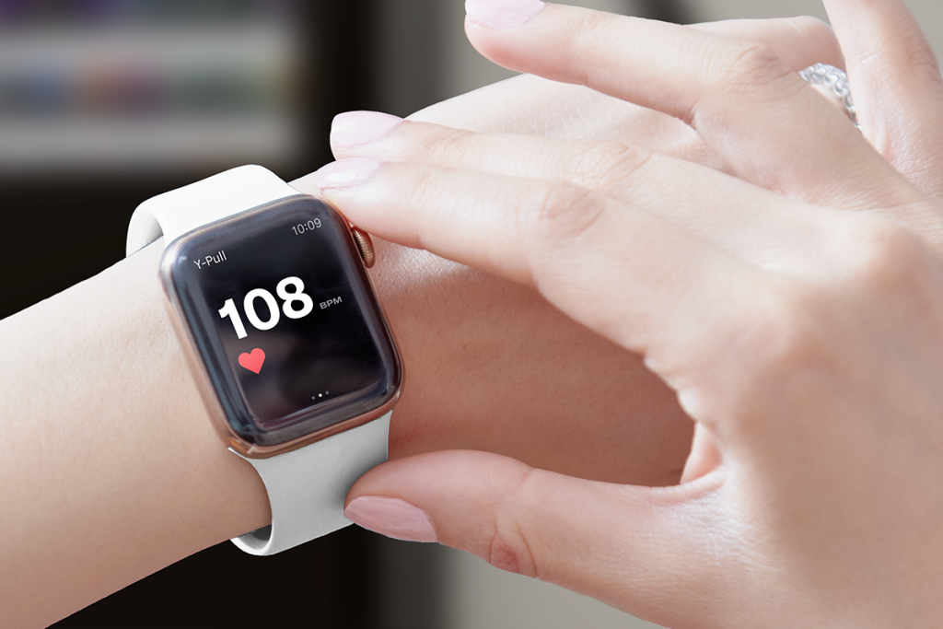
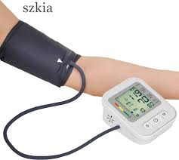
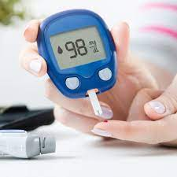
INTRODUCTION
Population Mindset
Since the pandemic, people are focused on monitoring their health more than ever. Usage of pulse oximeters is on the rise. Fitness bands, apple watches, fitness apps are a part and parcel of people’s lives.
Commonly used medical devices at home
Thermometer, Digital blood pressure monitor, Pulse Oximeter, Glucometer, Inhaler machine
10 hot new home medical devices that are lifesavers
Under Armour Healthbox, TempTraq application, Emfit QS Sleep Monitor, Withings Thermo, Hush earplugs, Qardiobase, Owlet Smart sock Baby Monitor, Beddit SmartSleep, etc.
Device Mechanism, Costs, Challenges of tests
Easy to use at home, requires contact with the body, avoid doctors visit, inaccurate measurements depending on the brands of devices
Trivial yet important questions
What are the challenges in the medical devices and the hospital visits?
Are people able to diagnose their medical condition accurately?
Can multiple people use the same devices?

Slide 3
MOTIVATION
Blood Pressure and Oximeter are in direct touch with the skin
Used with multiple patients with or without disinfection
COVID-19 -increase in risk of infections
Remodel the medical diagnosis of patients
Advanced technology to monitor health with the help of ‘at-home’ devices.
This led us to think deeper about the various applications of the existing contactless PPG technology which is used in most of the smart watches used by many fitness enthusiast.

Slide 4
RELATED WORK
Used smart phones to monitor heart rate, blood oxygen saturation, and blood pressure by placing finger on camera and analysing green and red channels [10]
SPO₂ prediction using digital camera and again analysing green and red channels [13]
BP estimation from PPG using MIMIC || database
All the related work used color channels for estimations [9]
Our Approach - Red signals with infrared signals
Notes:
Reference: https://encyclopedia.pub/item/revision/31e50a05ce0d61489848472e9755fcac
<number>

Slide 5
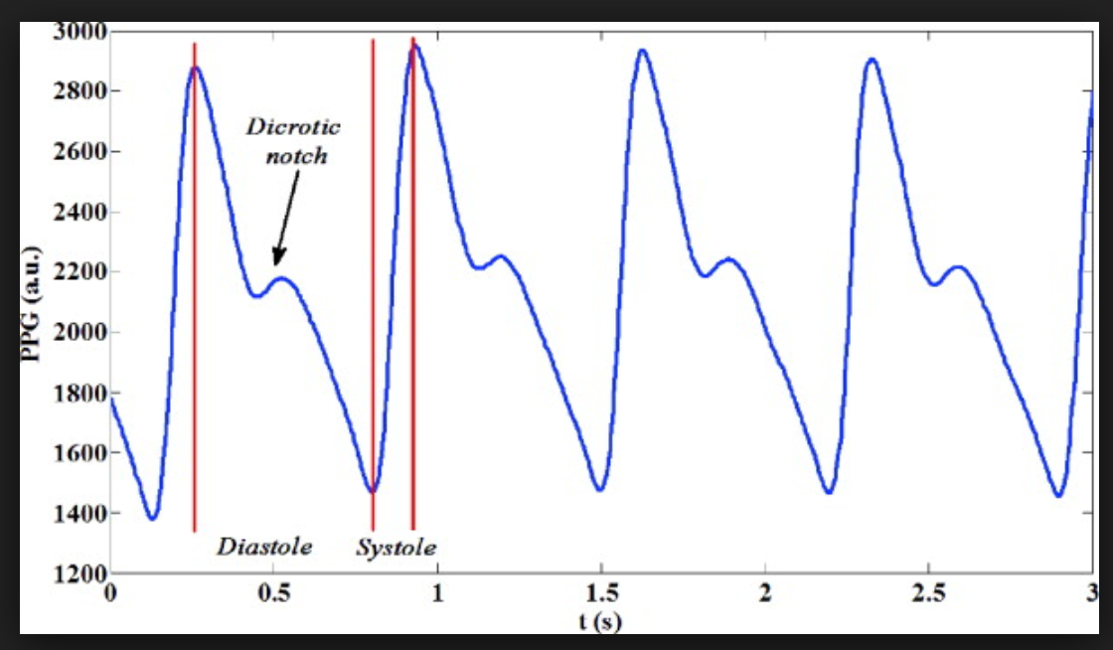
PHOTOPLETHYSMOGRAPHY (PPG)
Simple optic technique
Used to detect volumetric changes in blood in peripheral circulation.
Simple and inexpensive optical measurement method
Uses a light source and a photodetector
Measure variations in the blood circulation in terms of volume.
Blood travels from the left ventricle towards the face – Systolic peak
Blood pressure reflected from small blood vessels – Diastolic Peak
Relies on measuring the rapid variations in light absorption
Caused by the difference in absorption curves for oxygenated and non-oxygenated blood.
The amount of absorbed light is proportional to the blood volume flow in the exposed area.
Volume of the blood is related to the speed with which blood flow
And pressure are exerted on the arteries
Used for the measurement of SPO2 and BP.
Notes:
Ref1: www.news-medical.net
Ref2: www.ncbi.nlm.nih.gov
<number>

Slide 6
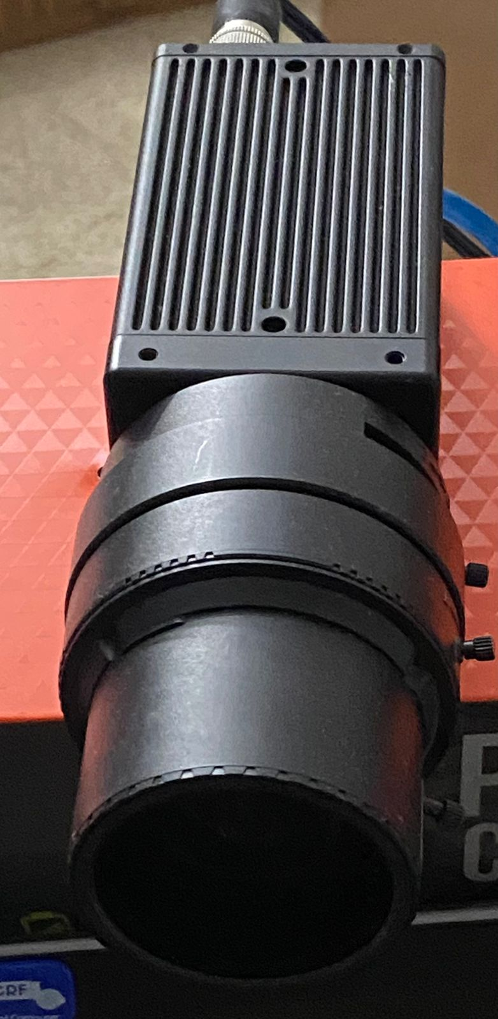
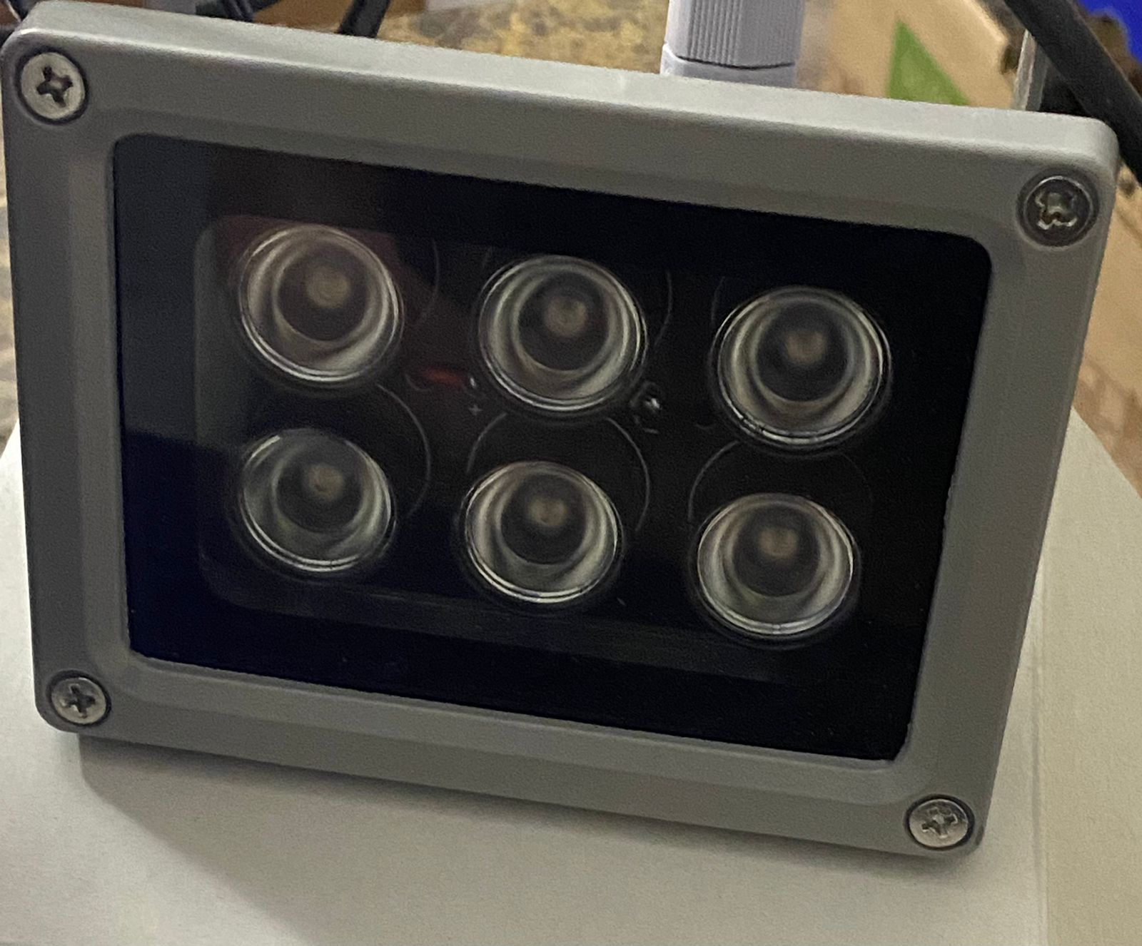

EQUIPMENTS USED
AD-080-GE camera
Multispectral camera - RGB and NIR
LED lamp for colored images
ES – IR1206U IR Illuminator
Capture IR images (wavelength > 940 nm)
Oximeter
Sphygmomanometer
Important Observations:
These images record the diffused absorption that indicates the change in the blood vessels.
The camera is used for robust monitoring.
Depending on the illumination changes, multispectral cameras will help us to extract the cardiac signals and its components.
For blood oxygen saturation, at least two different wavelengths must be simultaneously measured.
Notes:
Ref1: https://encyclopedia.pub/item/revision/31e50a05ce0d61489848472e9755fcac
Ref2: https://www.ncbi.nlm.nih.gov/pmc/articles/PMC7309009/
<number>

Slide 7
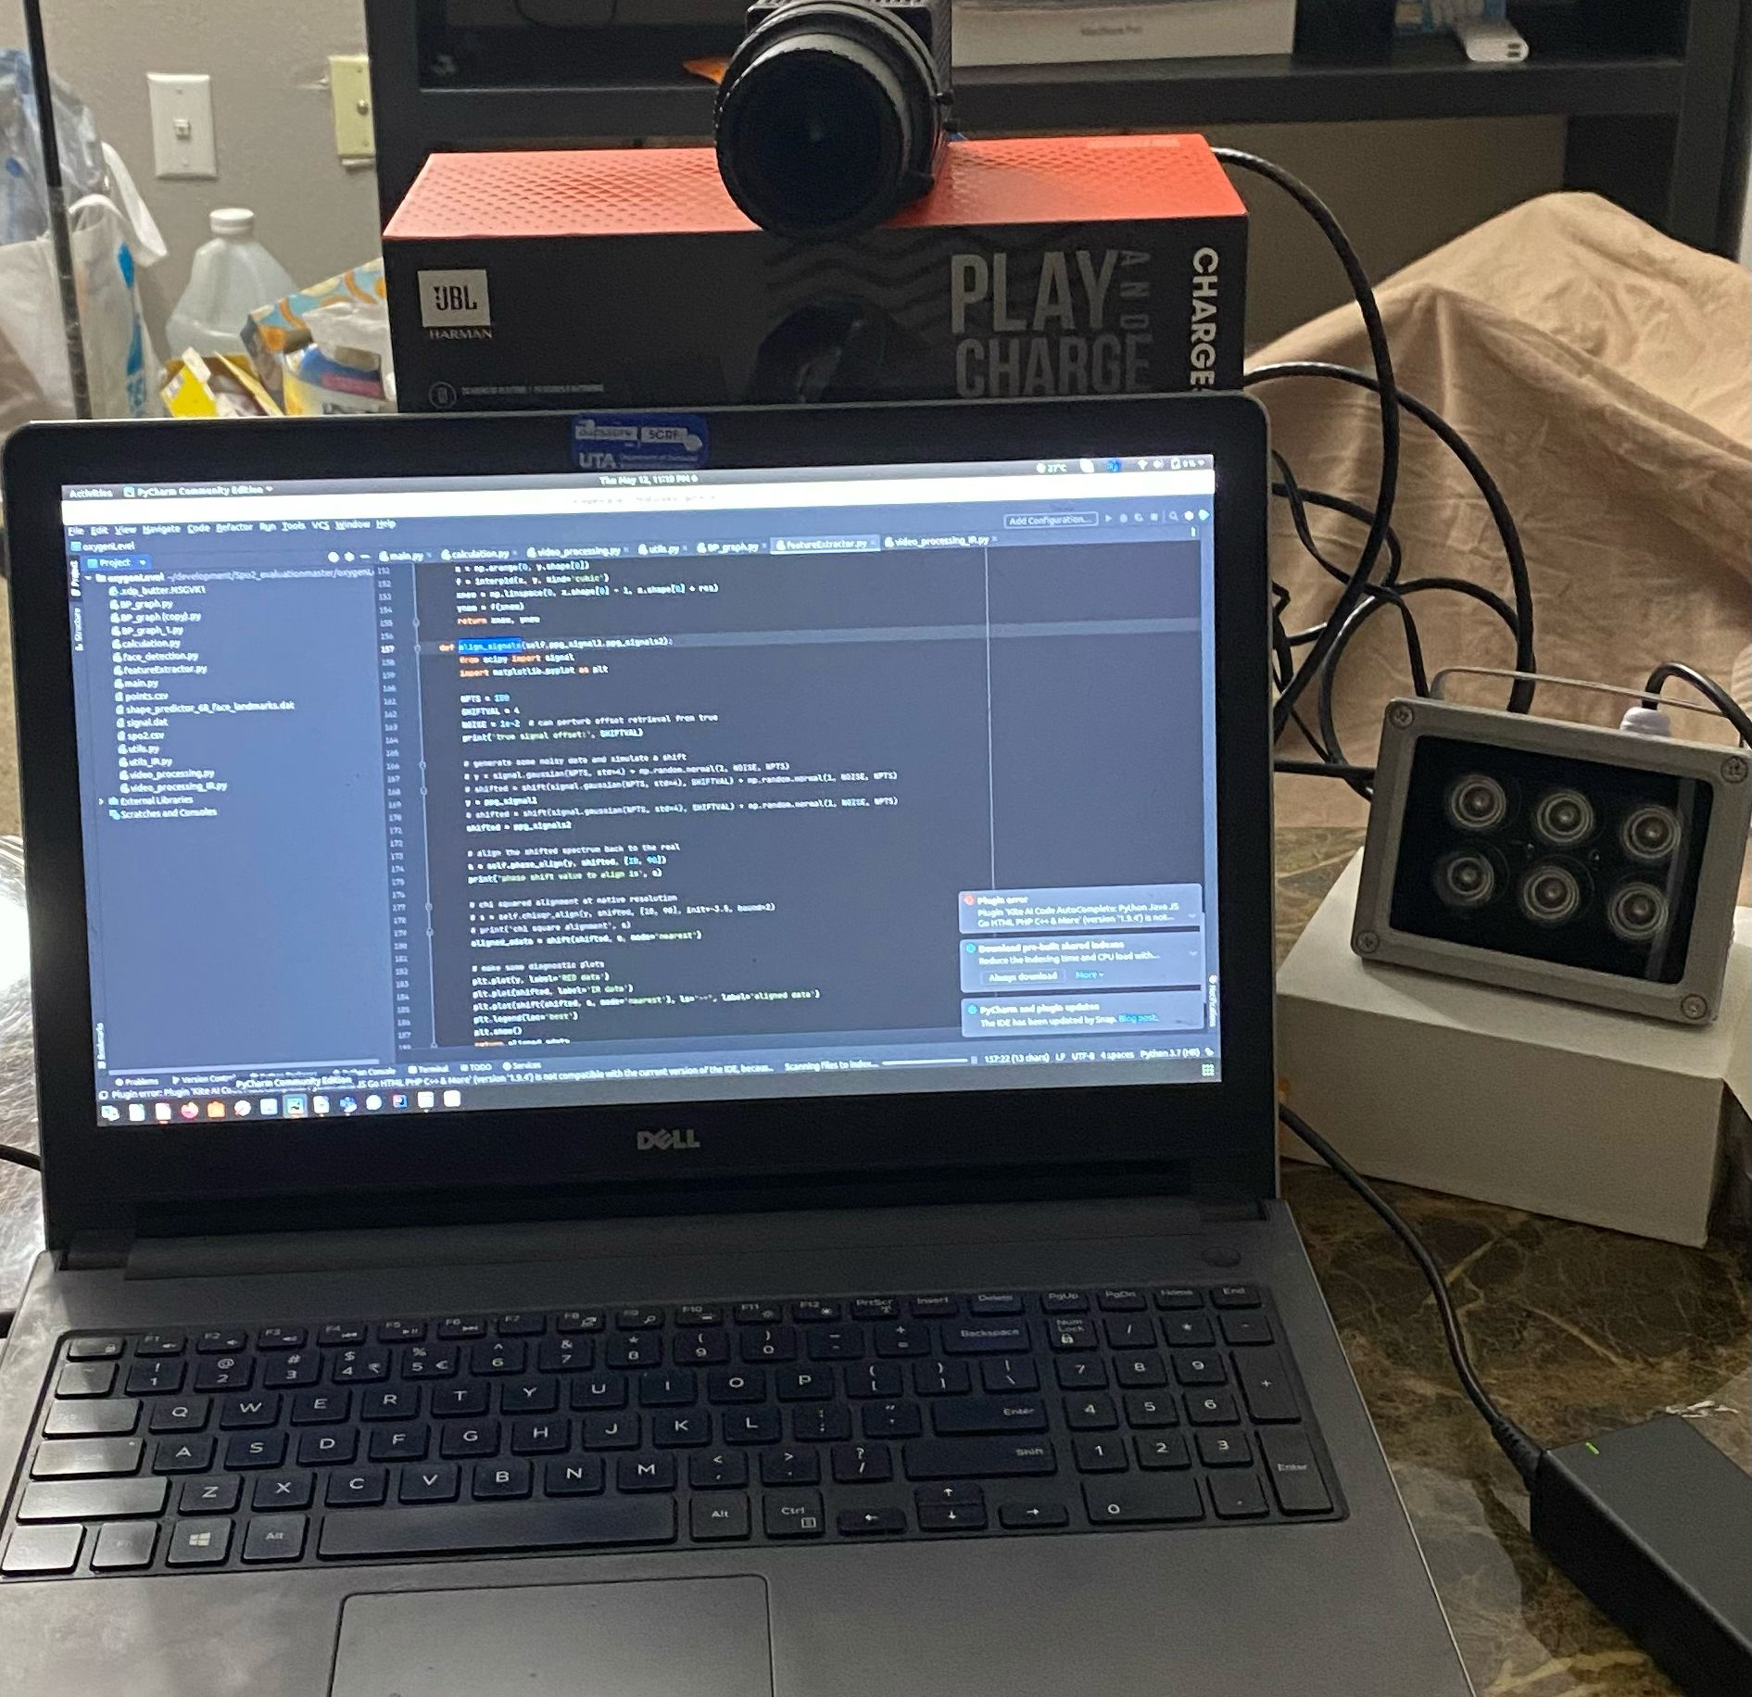




SYSTEM OVERVIEW
Person sits in front of system
Video (RGB + IR) started recording
BP measured using Sphygmomanometer
SPO₂ measured using oximeter
Illuminator
Camera
Computer

Slide 8
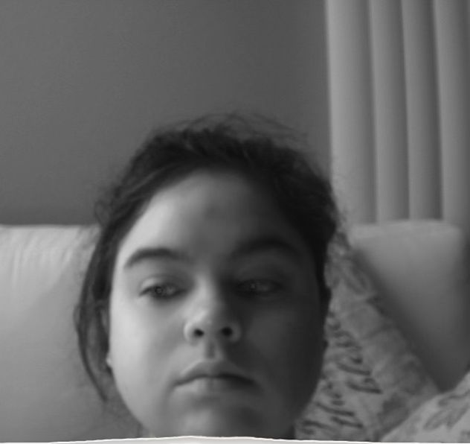

DATA CAPTURE
Person sits in front of system
Record videos each of 30 second
RGB video
IR video synchronously

Slide 9
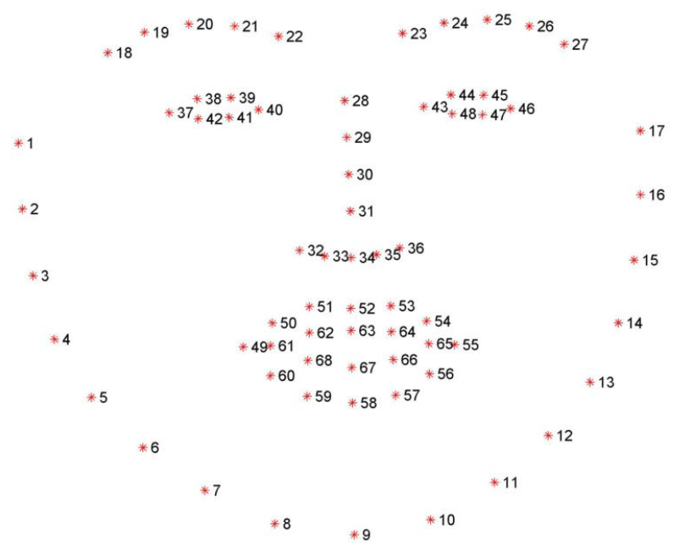
FACIAL LANDMARK EXTRACTOR
Facial Landmark Extractor
Estimate the location of 68 (x,y) coordinates
Map to the facial structures on the face

Slide 10
REGION OF INTERESTS
The bounding box for the detected face in each frame.
Two bounding boxes - the right and the left cheek
2 Regions of Interest (ROIs)
A spatial average of the color channel and IR channel pixel values (0-255)
Denote those regions as R_{i} where i=1,2,……..,n_{r}.
For each video frame V_{j} := V(_{jr}) belongs to R_{nxm}, j=1,2,…,t,
Compute the average value on each region R_{i}
$y_{i},_{j}=\frac{1}{R_{i}}ΣV_{j}\left(x,y\right)$

Slide 11
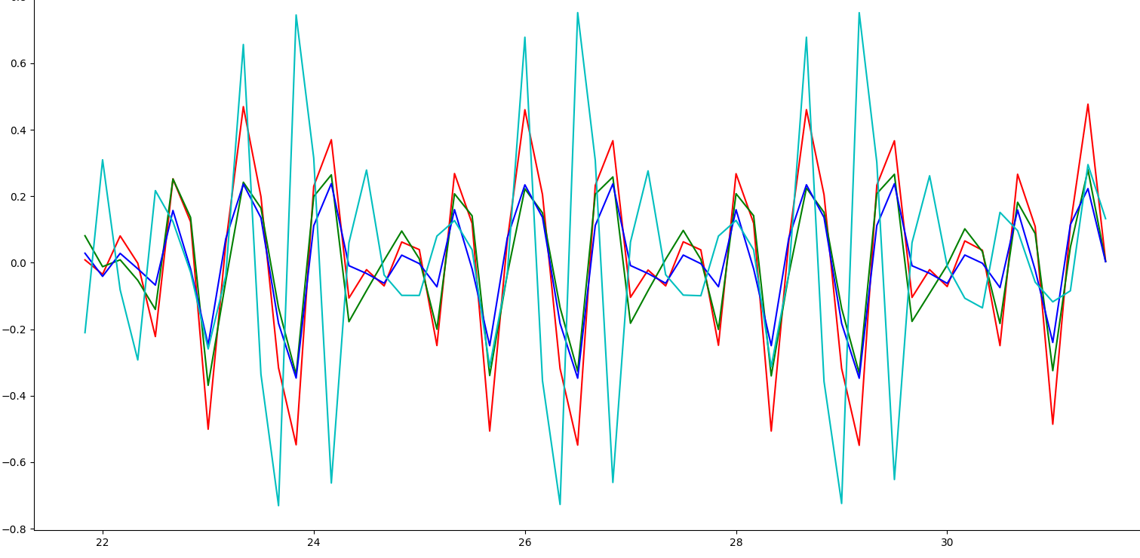
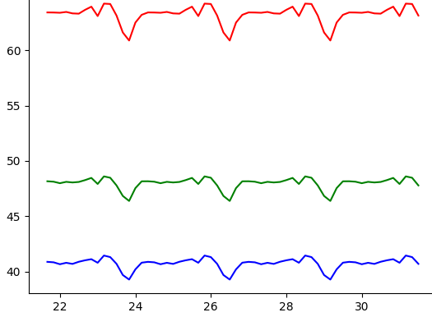
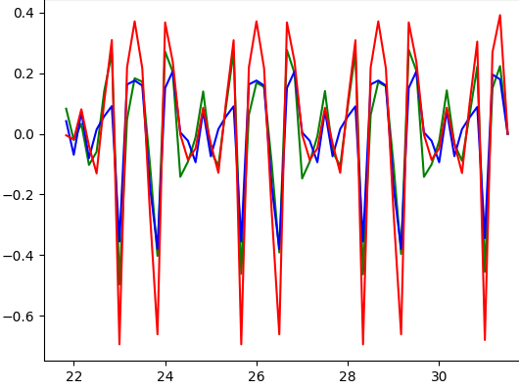
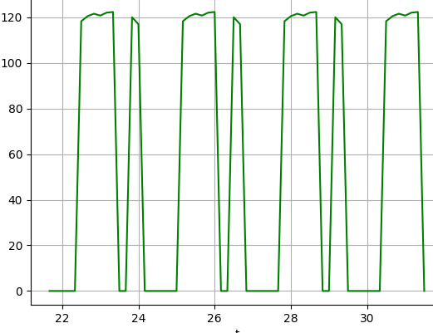
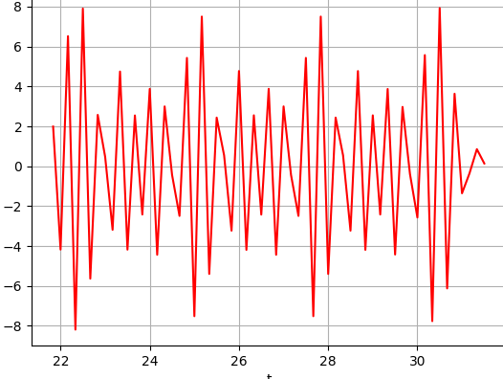
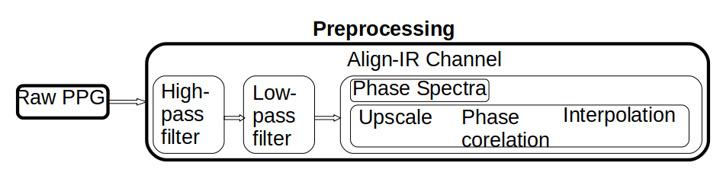
PRE-PROCESSING OF SIGNALS
Raw PPG signals
Filtered using Butterworth high bandpass and low bandpass with orders 2 and 4 respectively
Peaks visually verified
No clinically approved ground-truth method
High pass
Low pass

Slide 12
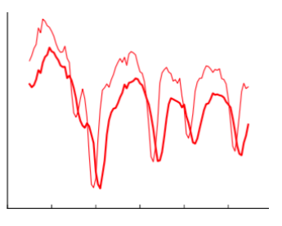
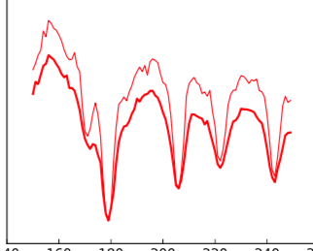
PRE-PROCESSING OF SIGNALS
The red, green, and blue signals are already aligned
Maxima and minima at the same time (s)
IR channel is a little shifted.
Align the IR channel with the Red channel.
Alignment technique is labeled as "phase spectra".
Phase correlation in Fourier space.
Cross-correlate data at the native resolution - achieve integer precision
Achieve sub-pixel or fraction precision
Upscale the data before doing cross-correlation
We upscale data N times to achieve 1/N precision as far as shift value goes
Aligned IR and Red

Slide 13
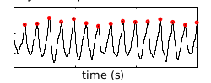
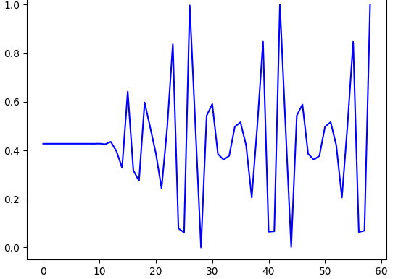
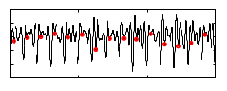
PRE-PROCESSING OF SIGNALS
The strongest BVP signal is selected and inverted if inverted signals are stronger.
Noise removed by taking beat having systolic peak, dicrotic notch and diastolic peak
Normalized to 1
Systolic Peak Detected
Remove Noise
Diastolic Peak Detected

Slide 14
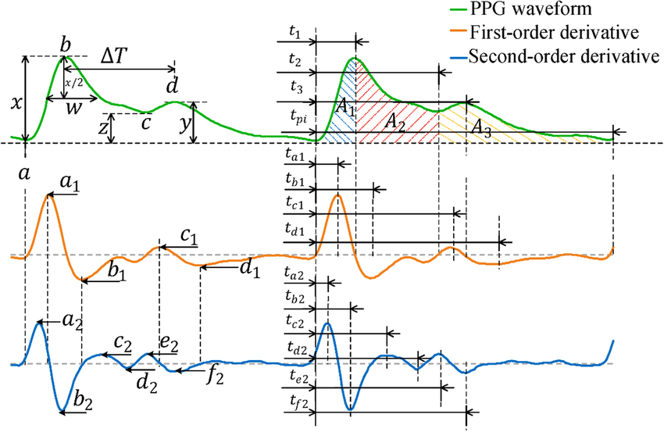
FEATURE EXTRACTION
Feature Extraction in Filtered PPG
The systolic peak detected
Dicronotic notch detected
Diastolic peak detected in filtered ppg.
The maxima - systolic peak ( Peak detection algorithm)
Second-order derivative of the waveform - diastolic peak
Mostly, the largest minima with second-order derivatives correspond to systolic peaks, and minima following these correspond to diastolic peaks
The systolic-diastolic peak-to-peak is considered to be one beat

Slide 15
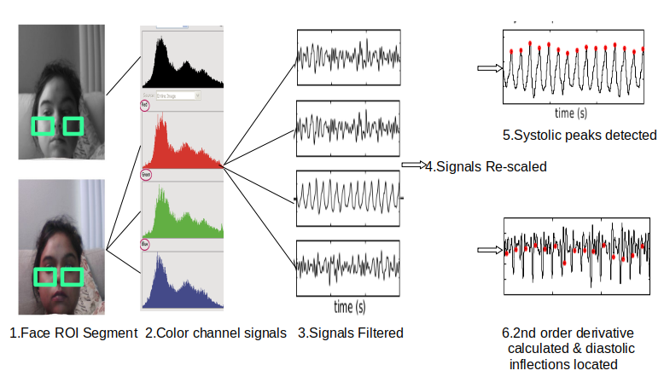
SIGNAL EXTRACTION

Slide 16
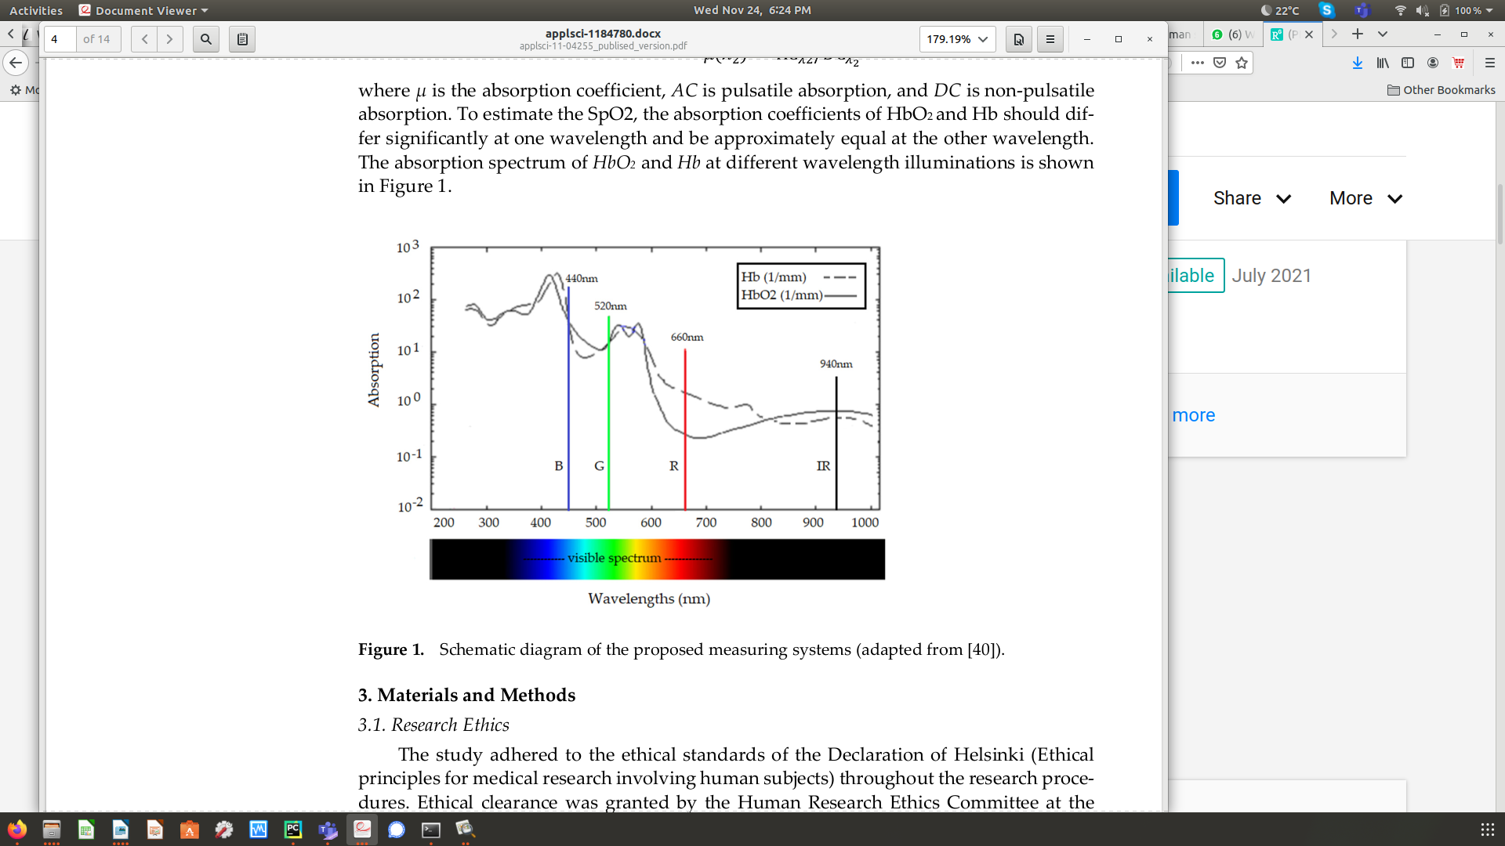
PROPOSED METHOD - SPO2
Oxyhemoglobin(HBO₂) - oxygen-carrying form of hemoglobin
De-Oxyhemoglobin(HB) - hemoglobin not combined with oxygen
SPO₂ = ratio of hemoglobin carrying oxygen to the total amount of hemoglobin
The wavelengths in the IR are absorbed by the oxyhemoglobin more than the ones in the Red
The wavelengths in the Red are absorbed by the de-oxyhemoglobin more than the ones in the IR
SpO2 % is evaluated by monitoring the variation of the light intensity in the Red and infrared color channels.

Slide 17
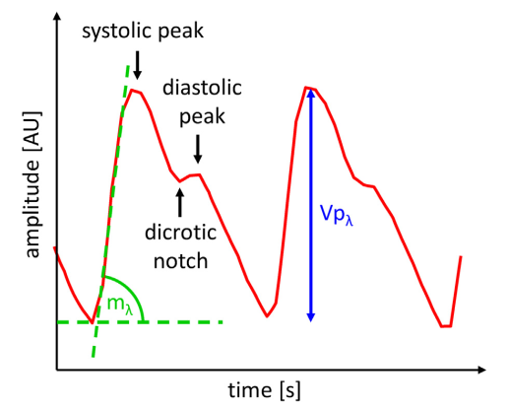
PROPOSED METHOD – SPO2 (cont.)
At the wavelength red and infrared the oxy- and the deoxy-hemoglobin show big differences in the absorption
These wavelengths correspond to the ones used in the pulse oximeter
Estimate SPO₂ - parameters required
λ is each color
Height of systolic peak Vp_{λ}
Slope of systolic peak m_{λ}
Oxygen level was calculated for each beat
and denote the absorption coefficients of de-oxyhemoglobin and oxyhemoglobin, respectively for each wavelength λ.
.
$ϵ_{Hb}$
$ϵ_{HbO2}$

Slide 18

PROPOSED METHOD – SPO2 (cont.)
Equation used to calculate SPO₂ is as follows:
${SPO}_{2}=\frac{ε_{Hb},_{IR}\sqrt{m_{R}ln\left({Vp}_{R}\right)}−ε_{Hb},_{R}\sqrt{m_{IR}ln\left({Vp}_{IR}\right)}}{\sqrt{m_{R}ln\left({Vp}_{R}\right)}\left(ϵ_{Hb},_{IR}−ϵ_{HbO2},_{IR}\right)−\sqrt{m_{IR}ln\left({Vp}_{IR}\right)}\left(ϵ_{Hb},_{R}−ϵ_{HbO2},_{IR}\right)}$
Normal SPO2 ranges from 95% - 100%
SPO2(%) can be calculated using below equation
μ is a constant and mean of errors
${SPO}_{2}\left(\text{\%}\right)={SPO}_{2}∗100±μ$

Slide 19
RESULTS - SPO2
5 Healthy individuals
Used commercial pulse oximeter FS20F Fingertip Oximeter
Comparison with RGB-NIR camera readings
 | SPO2% pulse oximeter | SPO2% RGB-NIR Camera
Subject 1 | 98 | 96.4
Subject 2 | 97 | 97.4
Subject 3 | 99 | 97.5
Subject 4 | 98 | 98.5
Subject 5 | 99 | 96.5
SPO2 Result varies between 96% to 99%
Mean Absolute Error calculated is 2.2
Standard Deviation calculated is 0.18
These fluctuations are due to monitoring of the individual from a distance of 30 m.

Slide 20
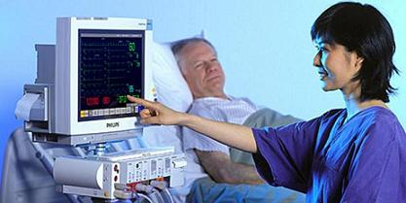
UCI DATASET - BP
Limited Data to train models
Need more data for training
Dataset from Physionet’s Multi-Parameter Intelligent Monitoring in Intensive Care Units (ICUs)
University of California, Irvine (UCI) repository
Cuff-less BP dataset
12000 signal parts of recorded ECG, PPG, and Arterial Blood Pressure (ABP)
Collected from 1000 individuals.
Data - pre-processed and validated.
PPG signals- Input
ABP signals – target
Also named MIMIC II dataset.

Slide 21
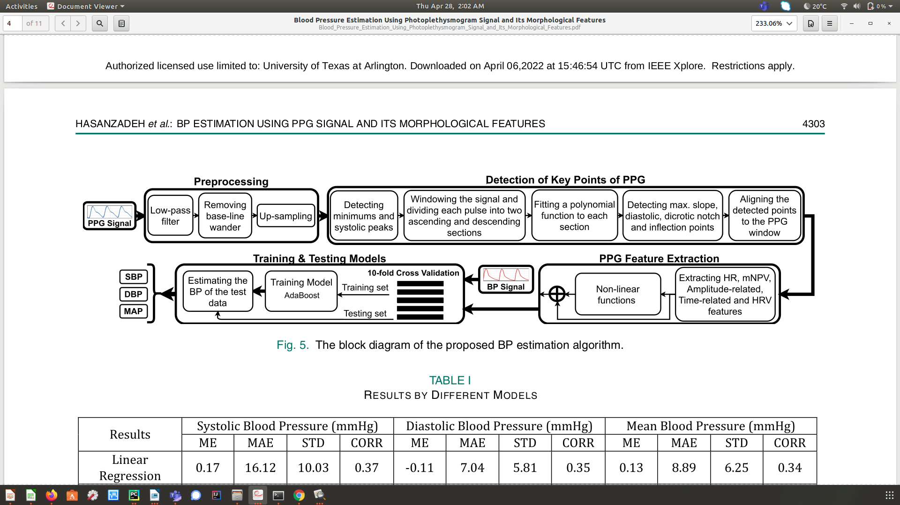
PRE-PROCESSING UCI DATASET - BP
The UCI Dataset is already pre-processed and validated
Steps include :
Low-Pass Filtering
Removing base-line wander
Up-sampling

Slide 22
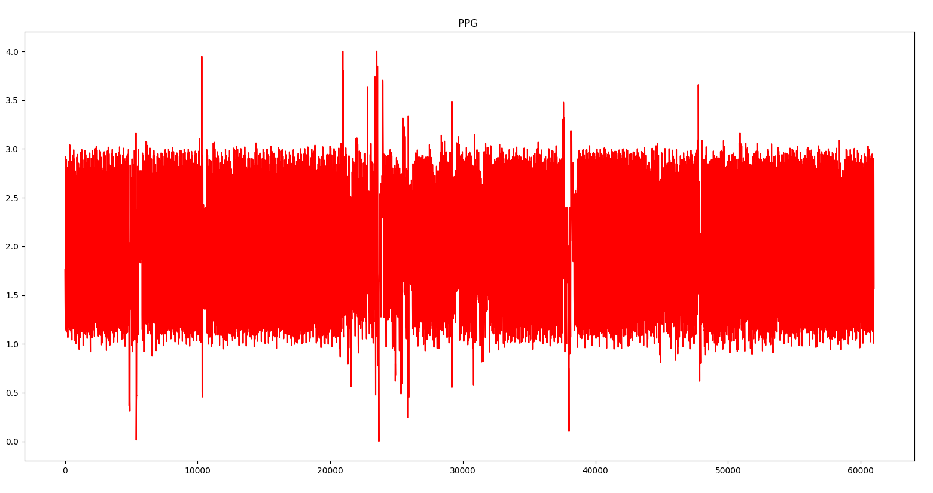
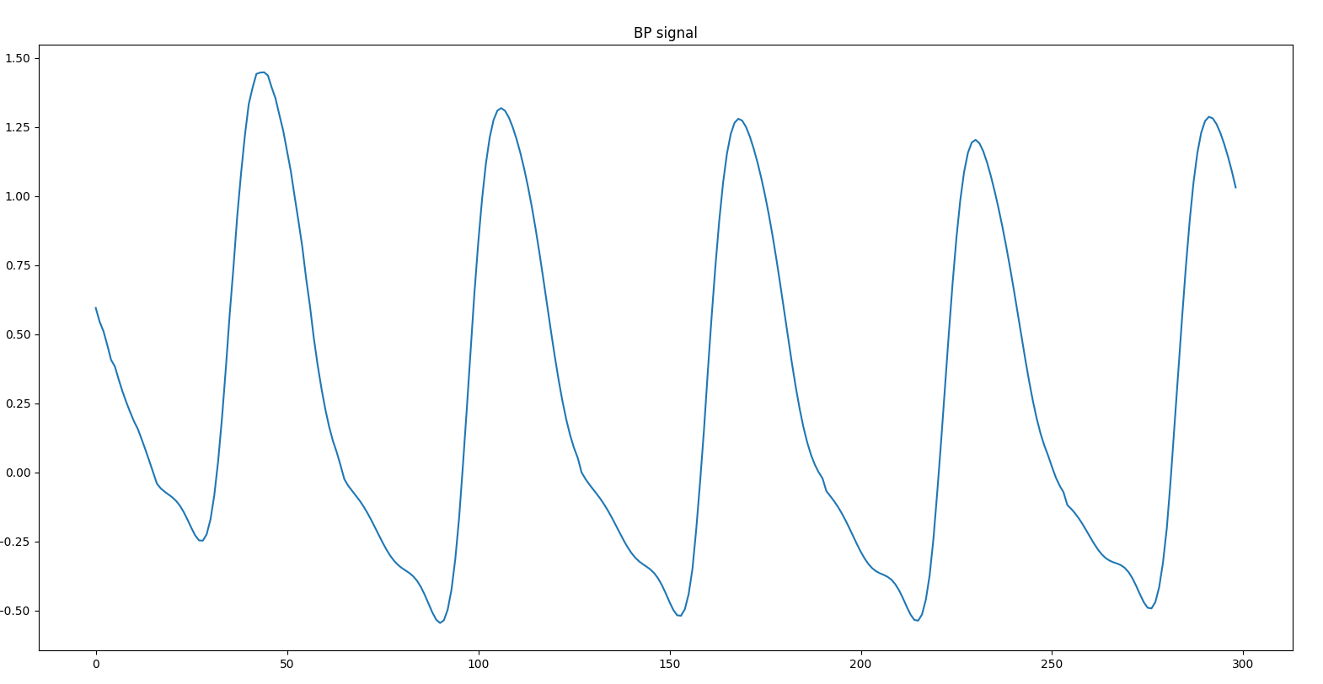
FEATURE EXTRACTION UCI DATASET - BP
For feature extraction algorithm , we used AMPD (Automatic Multiscale base Peak Detection)
algorithm to extract features.

Slide 23
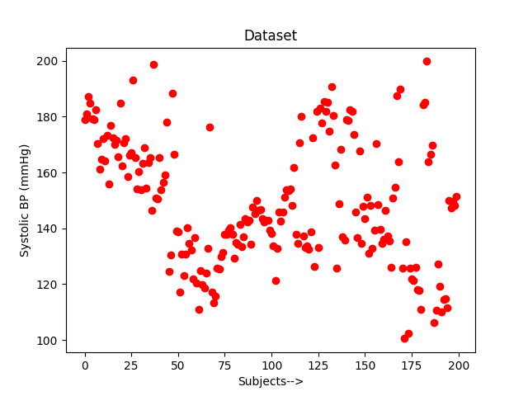
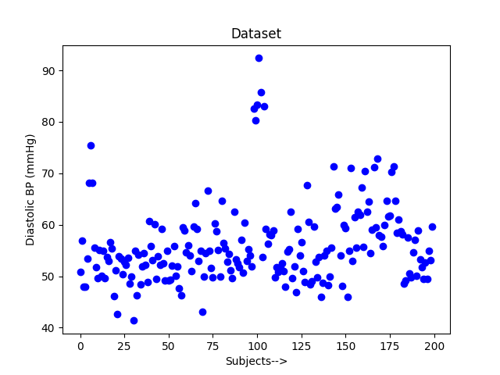
PROCESSED UCI DATASET - BP
The sample training datasets for 150 individuals randomly selected are shown in the figure after pre-processing and feature extraction algorithm

Slide 24
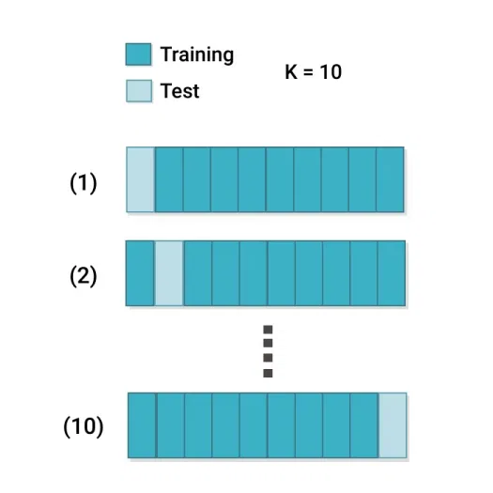
PROPOSED METHOD (BP)
UCI Dataset to train our model.
Supervised learning algorithm
4 Models trained and tested (Next Slides)
10-fold cross validation method - training/testing

Slide 25


PROPOSED METHOD – BP (cont.)
Models Used:
Decision Tree
Random Forest with a size of 100 trees

Slide 26
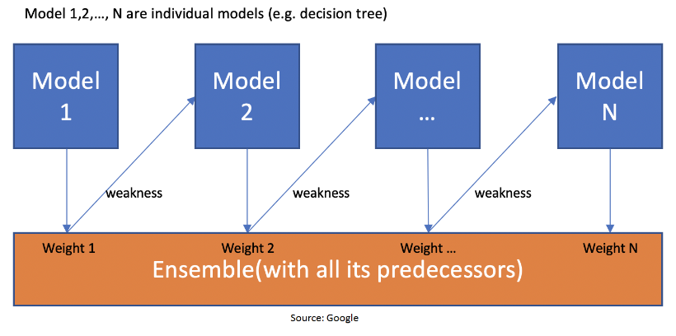
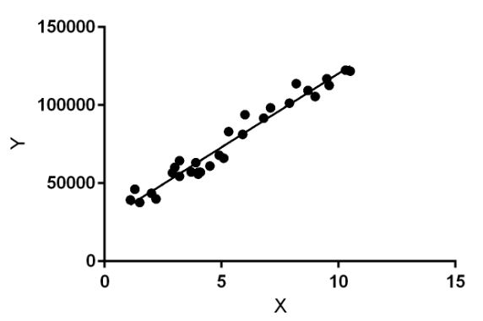
PROPOSED METHOD – BP (cont.)
Models Used:
Adaboost with the size of 200 decision tree estimator
Linear Regression

Slide 27
PROPOSED METHOD – BP (cont.)
Training and Testing Model

Slide 28
RESULTS - BP
Used commercial Sphygmomanometer OMRON M6
Comparison with RGB-NIR camera readings
Results | Systolic BP(mmHg) |  | Diastolic BP(mmHg)
 | MAE | STD | MAE | STD
Linear Regression | 29.67 | 0.9 | 13.0 | 0.5
Decision Tree | 60.75 | 6.6 | 5.5 | 5.0
Random Forest | 47.1 | 5.0 | 5.0 | 4.0
AdaBoost | 38.5 | 5.7 | 6.8 | 0.76
Mean Absolute Error (MAE)
Standard Deviation (STD)
Decision tree and Random Forest methods have surpassed methods like Linear Regression and Adaboost for diastolic BP.
While Linear Regression and Adaboost performed well as compared to Decision and Random Forest

Slide 29
CONCLUSION AND FUTURE WORK
Able to use PPG waveform which was captured from the RGB and NIR images from the camera to detect blood oxygen saturation (SPO2) measurement.
These measurements are essential for understanding cardiac health of the patient in a contactless way
Can be used with an illuminating device at a distance for more accurate measurements.
Alternative to devices that cause discomfort or patients with sensitive skin.
Same results as a pulse oximeter and BP machine
Reliable tool to correctly estimate the SPO2, BP and Heart Rate (in future).
Cost effective
Comfortably implemented with limited resources
Modified to accommodate advanced applications.

Slide 30
REFERENCES
[1] J. Allen, “Photoplethysmography and its application in clinical physio-logical measurement,” Physiological measurement, vol. 28, no. 3, p. R1,2007.
[2] J. Allen, C. P. Oates, T. A. Lees, and A. Murray, “Photoplethysmography detection of lower limb peripheral arterial occlusive disease: a comparison of pulse timing, amplitude and shape characteristics,” Physiological measurement, vol. 26, no. 5, p. 811, 2005.
[3] A. M. Brumfield and M. E. Andrew, “Digital pulse contour analysis: in-vestigating age-dependent indices of arterial
[4] K. Takazawa, N. Tanaka, M. Fujita, O. Matsuoka, T. Saiki, M. Aikawa,S. Tamura, and C. Ibukiyama, “Assessment of vasoactive agents and vascular aging by the second derivative of photoplethysmogram waveform,” Hypertension, vol. 32, no. 2, pp. 365–370, 1998
[5] M.-Z. Poh, D. J. McDuff, and R. W. Picard, “Non-contact, automated cardiac pulse measurements using video imaging and blind source separation,” Optics Express, vol. 18, no. 10, pp. 10 762–10 774, 2010.
[6] ——, “Advancements in noncontact, multiparameter physiological mea- surements using a webcam,” Biomedical Engineering, IEEE Transac-tions on, vol. 58, no. 1, pp. 7–11, 2011.
[7] D. McDuff, S. Gontarek, and R. Picard, “Improvements in remote cardio-pulmonary measurement using a five-band digital camera,” Biomedical Engineering, IEEE Transactions on, vol. 61, no. 9, 2014.

Slide 31
REFERENCES (cont.)
[8] J. J. Oliver and D. J. Webb, “Noninvasive assessment of arterial stiffness and risk of atherosclerotic events,” Arteriosclerosis, Thrombosis, and Vascular Biology, vol. 23, no. 4, pp. 554–566, 2003.[9] N. Hasanzadeh, M. M. Ahmadi and H. Mohammadzade, "Blood Pressure Estimation Using Photoplethysmogram Signal and Its Morphological Features," in IEEE Sensors Journal, vol. 20, no. 8, pp. 4300-4310, 15 April15, 2020, doi: 10.1109/JSEN.2019.2961411.
[10] Andrea Nemcova, Ivana Jordanova, Martin Varecka, Radovan Smisek, Lucie Marsanova, Lukas Smital, Martin Vitek, “Monitoring of heart rate, blood oxygen saturation, and blood pressure using a smartphone” in Biomedical Signal Processing and Control, vol. 59, 2020, 101928, ISSN 1746-8094, https://doi.org/10.1016/j.bspc.2020.101928.
[11] A. L. Goldberger et al., “PhysioBank, PhysioToolkit, and PhysioNet: Components of a new research resource for complex physiologic sig- nals,” Circulation, vol. 101, no. 23, pp. e215–e220, 2000.
[12] M. Kachuee, M. M. Kiani, H. Mohammadzade, and M. Shabany, “Cuffless blood pressure estimation algorithms for continuous health- care monitoring,” IEEE Trans. Biomed. Eng., vol. 64, no. 4, pp. 859–869, Apr. 2017
[13] Al-Naji A, Khalid GA, Mahdi JF, Chahl J. Non-Contact SpO2 Prediction System Based on a Digital Camera. Applied Sciences. 2021; 11(9):4255. https://doi.org/10.3390/app11094255

Slide 32
DATASET REFERENCES
Dataset References
https://archive.ics.uci.edu/ml/datasets/Cuff-Less+Blood+Pressure+Estimation

Slide 33
Any Questions, Observations or
Suggestions

